Slide 1
Predicting Diabetes with Logistic Regression
TEAM-16
Animesh Kumar-8
Payas S Nimje-32
Ruchita Singhal-42

Slide 2
Problem Statement - Predicting whether a person has diabetes or not by machine learning
Overview
We’ll be using Machine Learning to predict whether a person has diabetes or not, based on information about the patient such as blood pressure, body mass index (BMI), age, In particular, all patients here belong to the Pima Indian heritage (subgroup of Native Americans), and are females of ages 21 and above.
Method
We’ll be using Python and some of its popular data science related packages. First of all, we will import pandas to read our data from a CSV file and manipulate it for further use. We will also use numpy to convert out data into a format suitable to feed our classification model. We’ll use seaborn and matplotlib for visualizations. We will then import Logistic Regression algorithm from sklearn

Slide 3
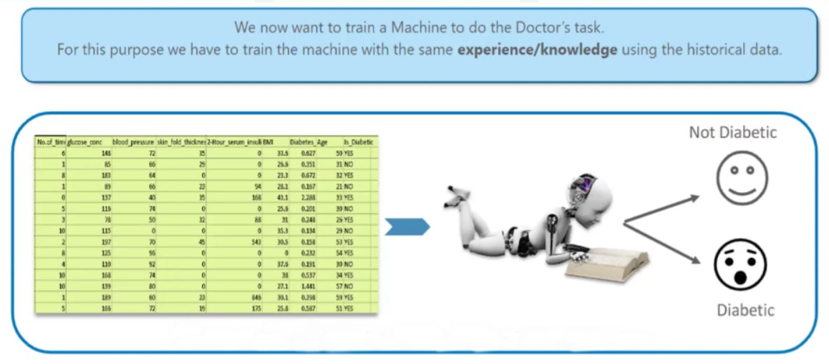

Slide 4
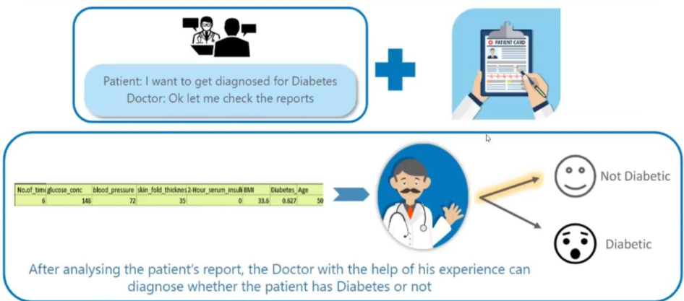
Business Implication

Slide 5
Data explanation
The following features have been provided to help us predict whether a person is diabetic or not
Pregnancies: Number of times pregnant
Glucose: Plasma glucose concentration over 2 hours in an oral glucose tolerance test
Blood Pressure: Diastolic blood pressure (mm Hg)
Skin Thickness: Triceps skin fold thickness (mm)
Insulin: 2-Hour serum insulin (mu U/ml)
BMI: Body mass index (weight in kg/(height in m)2)
DiabetesPedigreeFunction: Diabetes pedigree function (a function which scores likelihood of diabetes based on family history)
Age: Age (years)
Outcome: Class variable (0 if non-diabetic, 1 if diabetic)

Slide 6
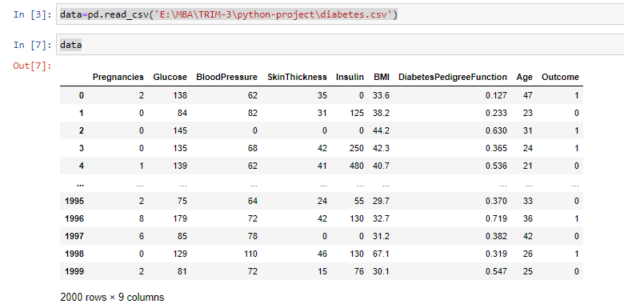
Data Description
We have our data saved in a CSV file called diabetes.csv. We first read our dataset into a Pandas data frame called diabetes, and then use the head() function to show the first five records from our dataset

Slide 7
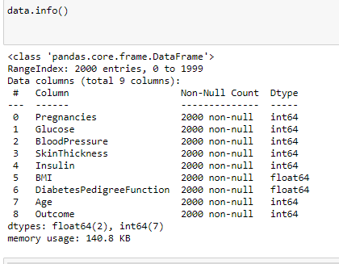
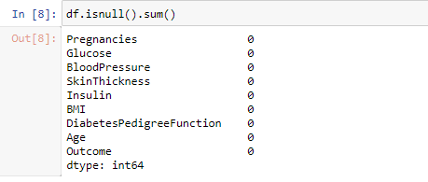
Let’s check the missing values in our dataset and Dataypes
We don’t have any missing values
We have 7 features as integer and 2 in decimal form

Slide 8
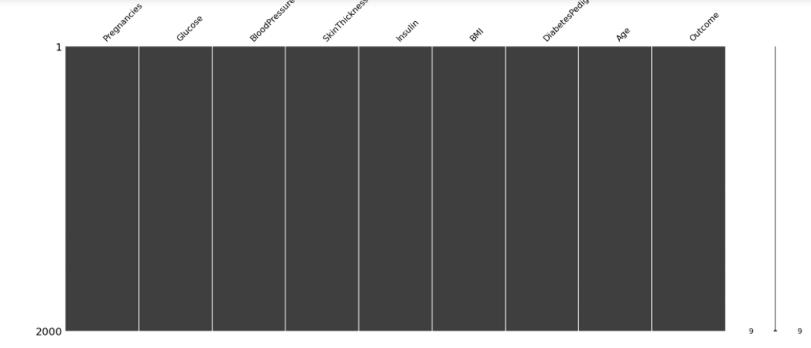
Check the missing values Through Missingno Plot

Slide 9
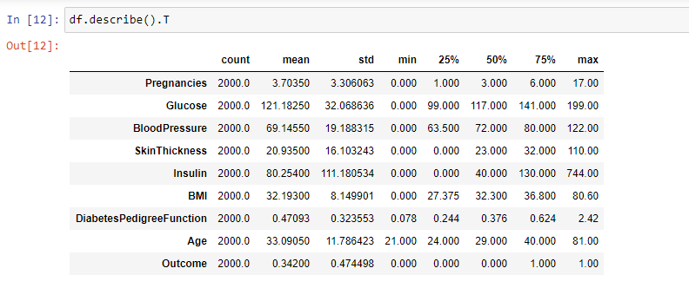
Data Description

Slide 10
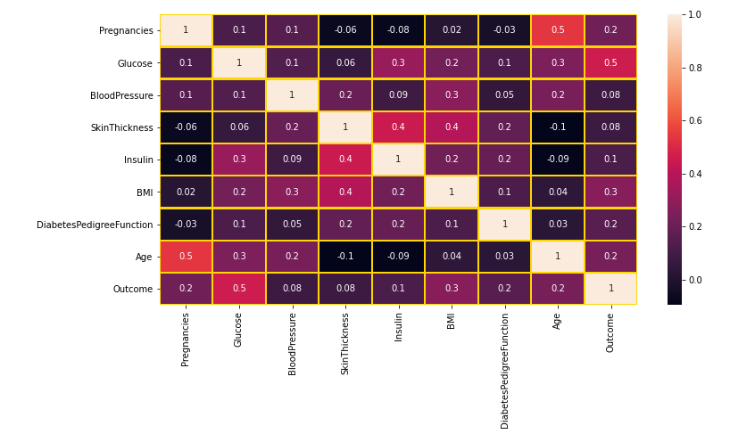
Exploratory Data Analysis
Correlation Matrix
As we can see from the table and the heat map, glucose levels, age, BMI have significant correlation with the outcome variable

Slide 11
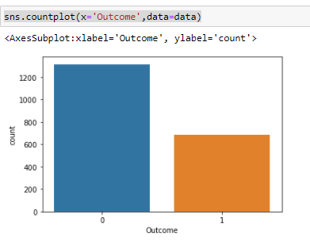

Slide 12
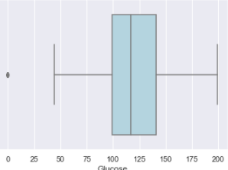
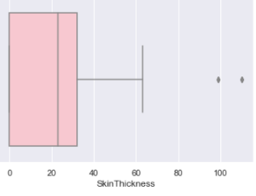
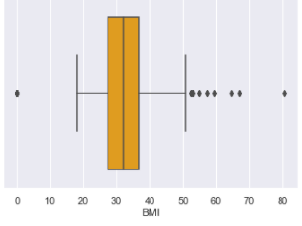
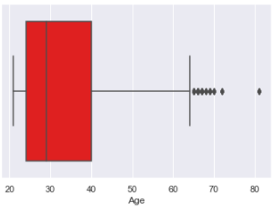
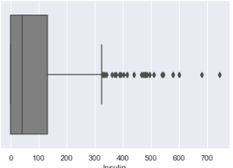
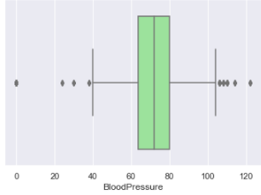
Check for outliers- the dots outside the boxplot shows the outliers

Slide 13
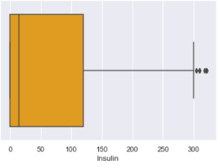
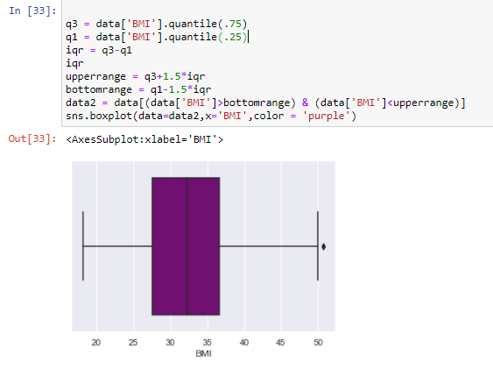
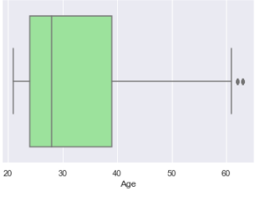
Treating Outliers- by use of Inter Quartile range
Insulin
BMI
Age

Slide 14
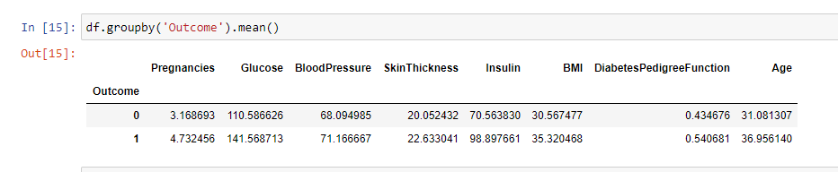
Analysis Through Mean Values grouped by Outcome(Likelihood)

Slide 15
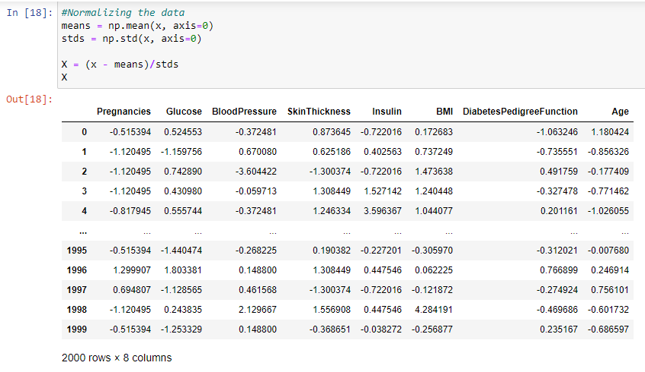
Dataset Preparation (Normalization)

Slide 16
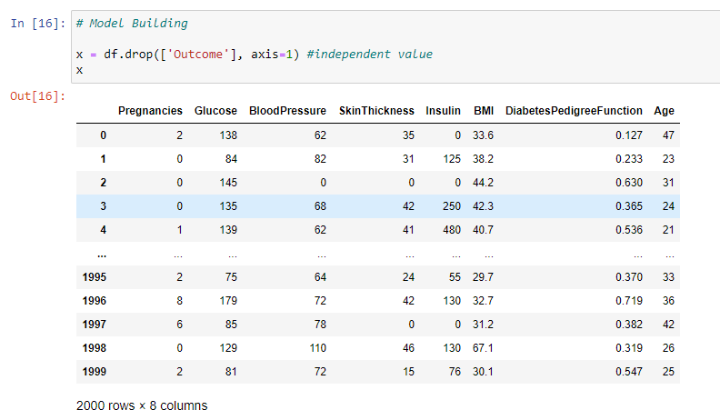
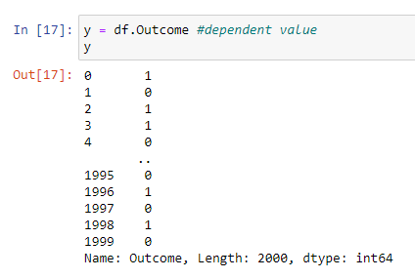
Segregating the data into Dependent and Independent variables

Slide 17
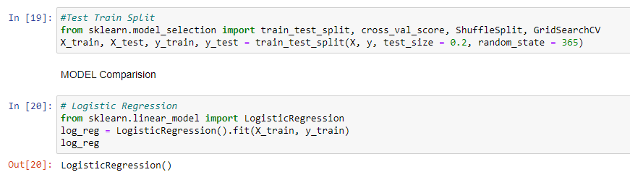
Splitting the data into training and testing set

Slide 18
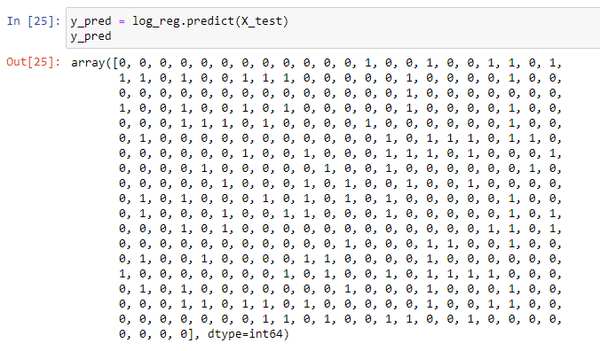
Model Prediction

Slide 19
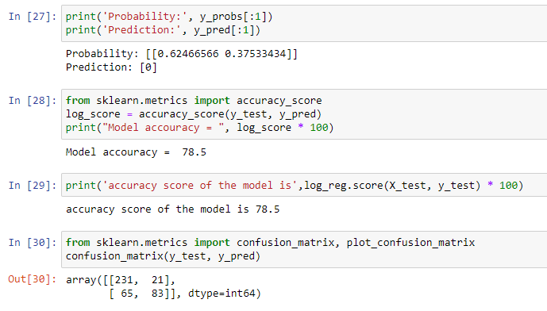
Prediction, Model Accuracy, Confusion Matrix

Slide 20
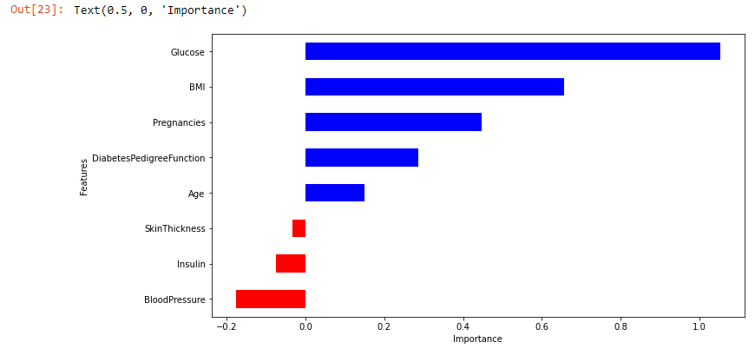
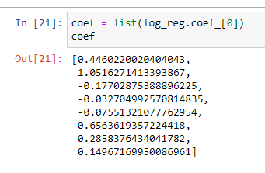
Variable Significance Level

Slide 21
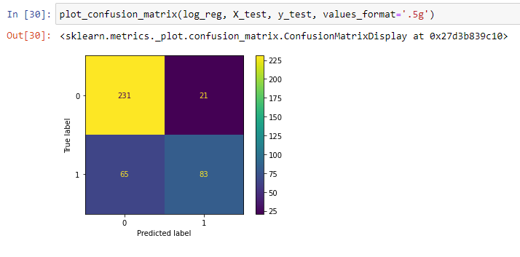
Confusion Matrix

Slide 22
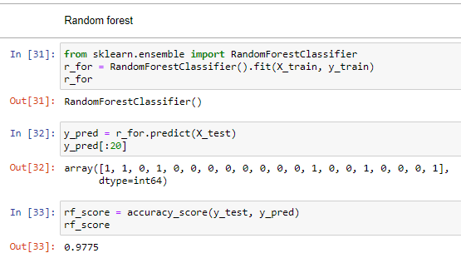
Comparing Logistic Model With other Classification Models
Random Forest

Slide 23
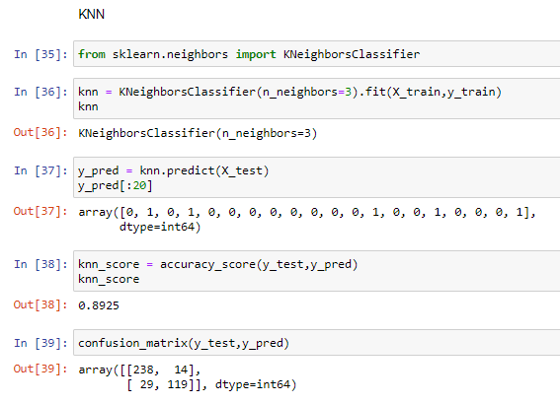
KNN

Slide 24
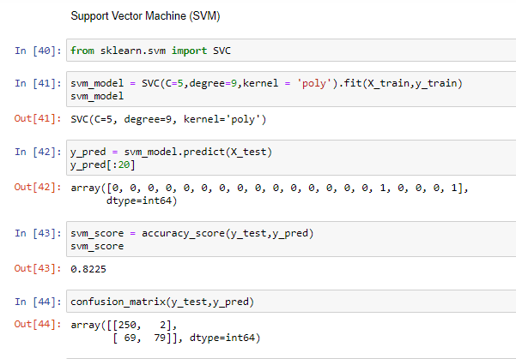
Support Vector Machine (SVM)

Slide 25
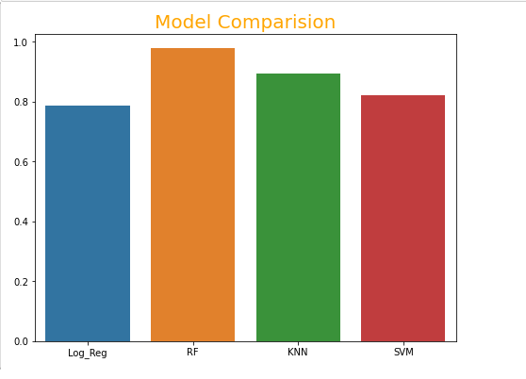
Model Comparison

Slide 26
THANKS!
GitHub Link for the project.
https://github.com/Payas10/Python_Project
https://github.com/Animesh100-Kumar/Python-Project_Diabetes-Prediction
https://github.com/RuchitaSinghal/Python-Project

